Slide 1



Hand gesture recognition in industry
By
Thiry Nicolas
Dumoulin William

Slide 2

01
Project
02
Dataset
03
Model
04
Accuracy
05
Demonstration
06
Limits
2/18

Slide 3
Project
01
3/18

Slide 4
Project
Goal of the project
Obligations
Gesture
Industry
4/18

Slide 5
Dataset
02
5/18

Slide 6
Dataset
12 persons, 10 gestures, 4 time each
1500 videos
61 frames
6/18

Slide 7
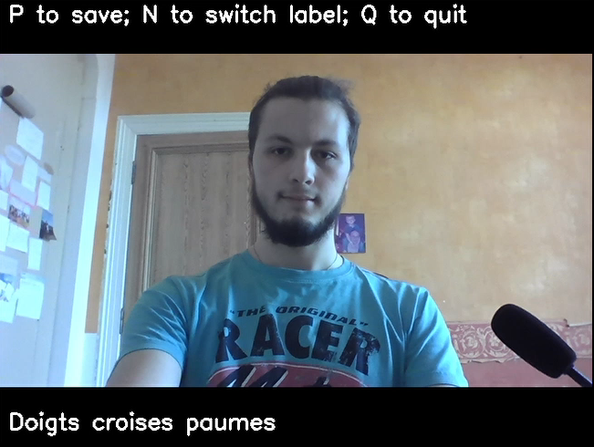
7/18

Slide 8
Model
03
8/18

Slide 9
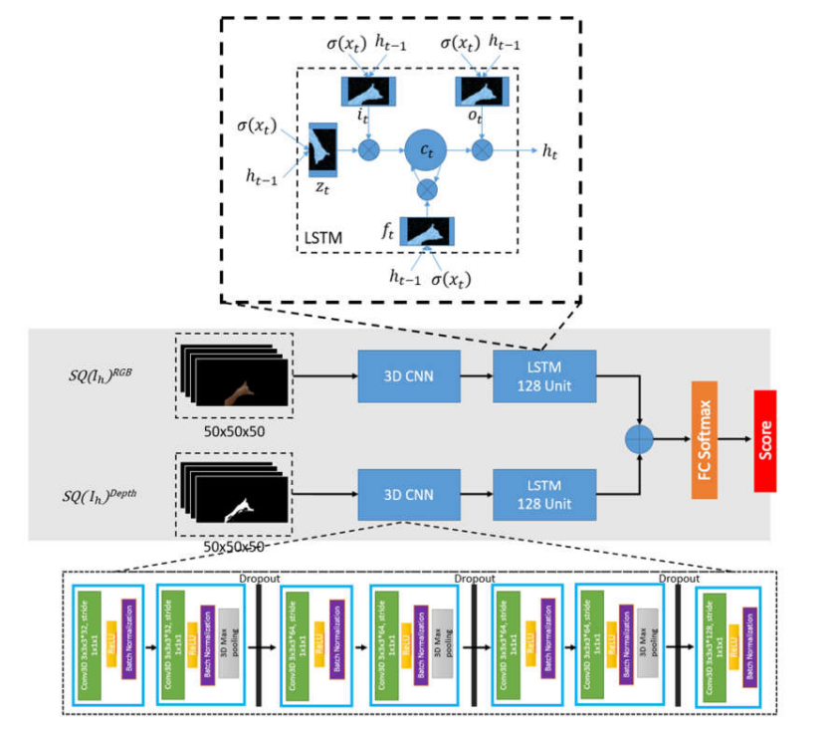
Model
“Dynamic Hand Gesture Recognition Using 3DCNN and LSTM with FSM Context-Aware Model”
Their accuracy = 92 %
9/18

Slide 10
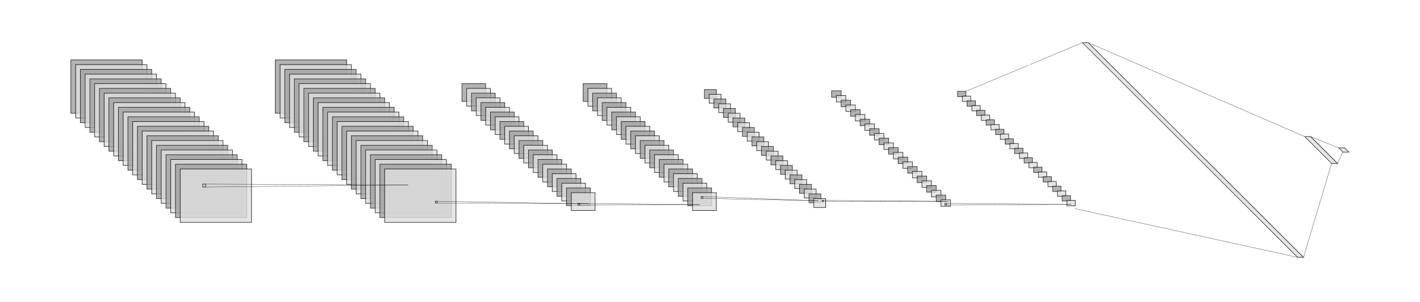
Our Architecture
10/18

Slide 11
Accuracy
04
11/18

Slide 12
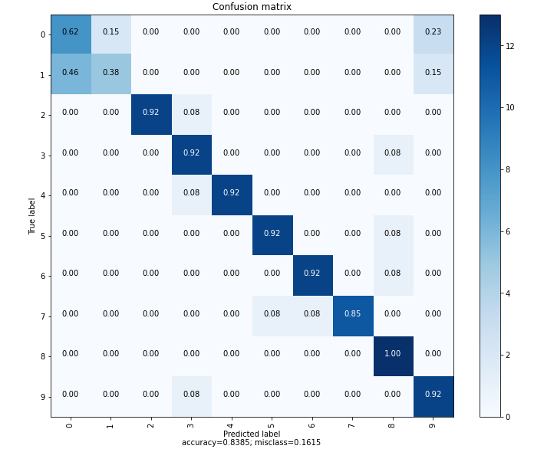
Accuracy
83,8%
12/18

Slide 13
Demonstration
05
13/18

Slide 14
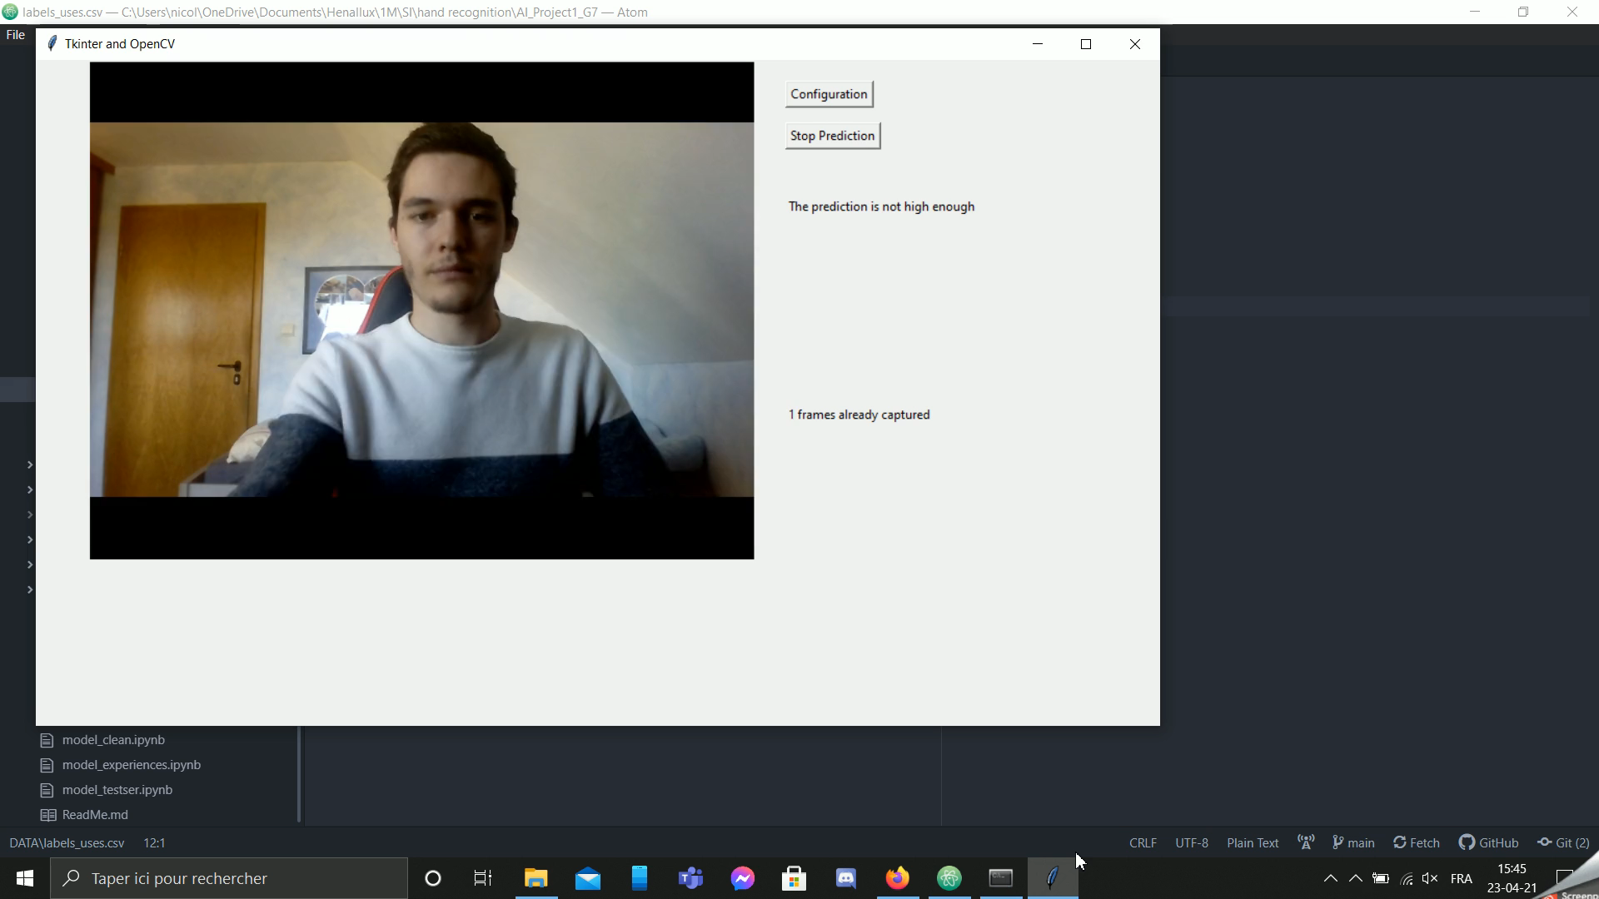

Slide 15
Limits
06
15/18

Slide 16
Limits and improvement
Viewing angle
Speed of the gesture
Camera-gesture distance
16/18

Slide 17

Thank You for your attention
Thiry Nicolas
Dumoulin William
17/18

Slide 18
Link to download the video : https://web.microsoftstream.com/video/aaebcfcf-b4fd-417d-8b2b-5d14f86f6238
18/18

